Slide 1

91 OG Auto Scheduler version 1.2
Quick Start Guide

Slide 2
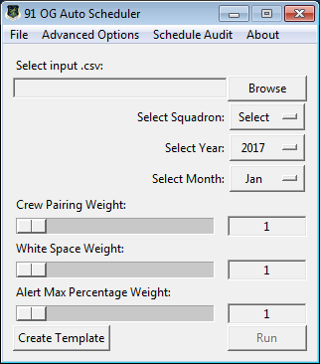
Program Interface
Displays Advanced Options
About the program
Weighted Variable Sliders
File menu
Displays Schedule Audit Window
Crew Pairing Weight: Increasing will favor crew
pairings.
White Space Weight: Increasing will favor MCCMs
with less white space in the remainder of the
month.
i.e.: A MCCM with a large block of leave at the end
of the month will be chosen for an alert over an
MCCM with no leave.
Alert Max Percentage Weight: Increasing will favor
MCCMs who have a lower percentage of their max
alert count dedicated to alert.
i.e.: an MCCM with 1/8 alerts assigned will be
chosen over an MCCM with 4/8 alerts assigned.
Browse for input spreadsheet (.csv)
Squadron Select Dropdown
Year Select Dropdown
Month Select Dropdown
Weighted Variable Values
Runs Program. Will not be clickable until an input
.csv and squadron have been selected.
Creates a template input spreadsheet (.csv)
to be filled out with squadron roster.

Slide 3
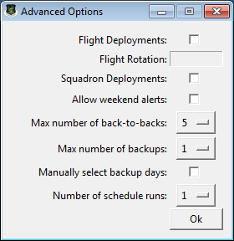
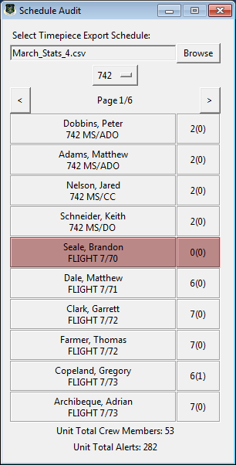
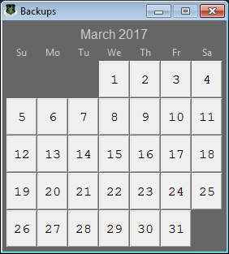
Program Interface
Advanced Options and Schedule Audit
Schedule Audit will allow the user to browse for a Timepiece export file that has first been saved as a .CSV (Comma delimited) format. The user can then browse through the selected squadron to determine if there are any schedule build issues for each individual. Issues will be highlighted in either red (critical issue) or yellow (minor issue). Hover over the highlighted crew member for a more detailed explanation of the issue(s).
Toggles Flight Deployments
Change flight rotation for flt. dep.
Toggles Squadron Deployments
Allows 2(0) alert pullers to go out on wknds
Adjusts maximum back-to-backs allowed
Adjusts maximum backups allowed
Adjusts number of schedule runs. Increasing this option will create multiple versions of the schedule. The program will choose the version with the least amount of holes for export. A large number of schedule runs may lead to long processing times.
Manually select backup days. If not selected, backup days will be assigned to a squadron automatically based on a three day rotation starting on 1 September 2016. Manually selecting backup days will be required if the backup construct changes in the future. Will also select squadron deployment days.

Slide 4
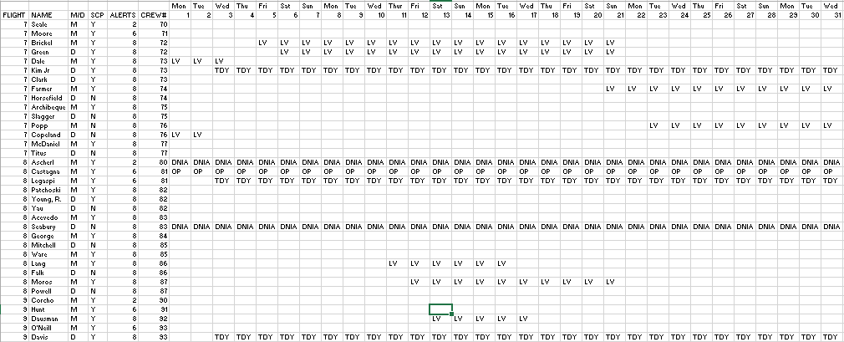
Input Spreadsheet
Note: First two lines consist of weekday information & column labels
FLIGHT: Numeric flight. Leave blank if W/T or Leadership
ALERTS: Max alert count (ie: 2 for flight commanders/leadership, 6 for schedulers, etc.)
NAME: Last name (and first initial if necessary).
CREW#: Used for crew pairings. Matching crew numbers will be treated as a crew pair.
M/D: Commander (M) or Deputy (D).
Month Layout: Add crew inputs. Added alerts will be considered part of the MCCMs alert
count when building the schedule, but must be entered in the following format:
Aa(M) (Alpha LCC Commander Alert) or Am(D) (Mike LCC Deputy Alert)
SCP: SCP Certified, Yes (Y) or No (N).
Note: Input spreadsheet MUST follow this format and MUST be saved as a .CSV file in order to work with the program.

Slide 5
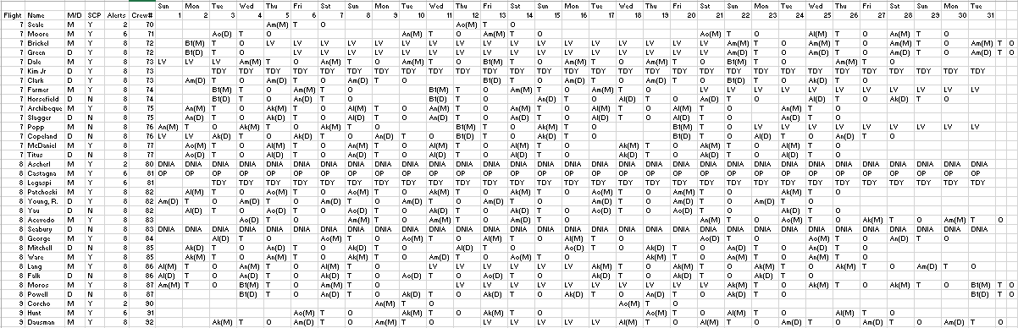
Output Example
Note: Output will consist of the same information provided in the input spreadsheet with alerts filled in as well.
Note: Output is in CSV (Comma Separated Variable) format, which is basic text and no formatting. The output will need to be
copied into a formatted excel spreadsheet for data visualization.

Slide 6
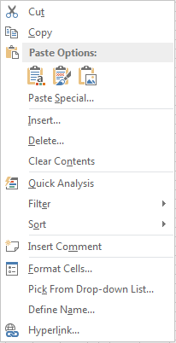
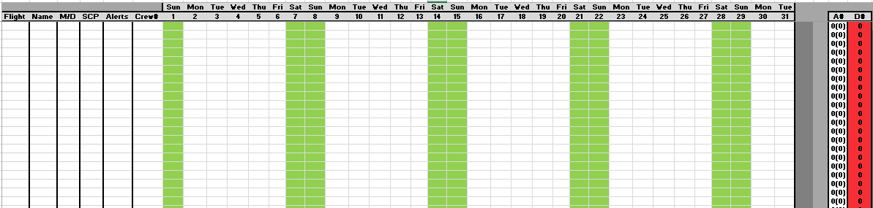
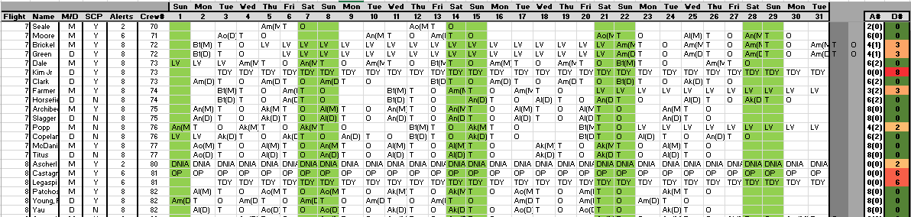
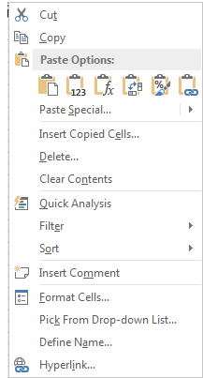
Transferring Output to Formatted Spreadsheet
Right click in the top left-most cell in the formatted spreadsheet.
Click the button to paste values only. If you copy and paste without selecting values only, formatting will be lost.
Admire your beautifully formatted data.
Select all schedule data to include two days after the end of the month to ensure you get T and O days.
Copy Data

Slide 7
Program Notes
If a person’s max alert count is less than 5, the program will not schedule them for alert on a Friday, Saturday or Sunday.
The program will always fill backup alerts first, then go day by day through the month to fill ACP/SCP first, and then PLCCs last.
The order that PLCC alerts are filled is random.
The program will calculate who is the best choice to fill an alert seat based on four factors:
Crew pairing
Alert load compared to other personnel
Remaining white space in the month
Eligibility (SCP certified, space for the alert, etc.)
If there is more than one “best choice” for an alert seat, the program will randomly choose one.
Backup days are automatically determined based on a three day backup responsibility per squadron starting with the 740th on September 1st 2016 (when the three day policy went into effect). If this policy changes, the program will need to be updated to accommodate different backup day assignment.
If the program is running for flight deployments, it will automatically determine how many flights there are based on the number of unique inputs in the FLIGHT column on the input spreadsheet. This means that the program will work with three flights, the possibility of four flights, or whatever the case may be.
The flight rotation is permanently programmed for now. To change which flight begins the rotation, a change to the programming must occur. A way for the user to determine which flight starts the rotation is in the works.
If using flight deployments, the program will attempt to only fill the alert with people from the flight who’s day it is. If this cannot be done, the program will choose anyone who is otherwise available.
By modifying the input spreadsheet, the program can handle a lot of unique situations. For instance, a code change schedule can be generated by blocking out everyone’s calendar for five days on the input spreadsheet and adjusting the ALERTS column of those performing code change to reduce their remaining alert load.
The program can make a rudimentary attempt at filling holes caused by sudden PRP/DNIA occurrences. By removing all alerts from an individual and using the resulting spreadsheet as a new input, the program will recognize all previously scheduled alerts and attempt to fill only the existing holes.
The program will automatically overwrite dates and days of the week when you run it for a given month/year. You do not need to pre-format the input spreadsheet with this information on the first two lines, but the lines DO need to be there.

Slide 8
Please Give Us Feedback!
This program is intended to be a tool to make your lives easier as squadron schedulers. If it is not accomplishing that task, let us know. We have free reign to implement updates and modifications, so if you think that it should work differently, or that it should do something else, just send the wing scheduling office an email or pop in and see us. If you have any questions regarding the program usage or how it works, ask Lt Benedetti!
I am departing missiles, but will be available for any program needs, as I have ways of getting an update to you. Feel free to email me at:
michael.benedetti@us.af.mil
-Benny

